Slide 1
Maker’s university – by intel’s makers community
Gil Tal.
Jan 2019

Slide 3
Expectations:
It is the first time – so I will be experimenting along with you all
Not everything is ready
We are creating something new!
I need help with infrastructure which is still work in progress
You can choose to be the instructor for the next classes ☺, at Intel or anywhere you choose
Most of the work will be done at your own free time
You are expected to complete missing knowledge you might have
C\C++ good knowledge is required

Slide 4
targets:
To take us a step up as an engineers
To expose us to new opportunities \ possibilities \capabilities
To enable us to execute small to medium projects – end to end
To train us as instructors to run similar course at schools\universities – to better expose Intel
To grow this new thing we are starting

Slide 5

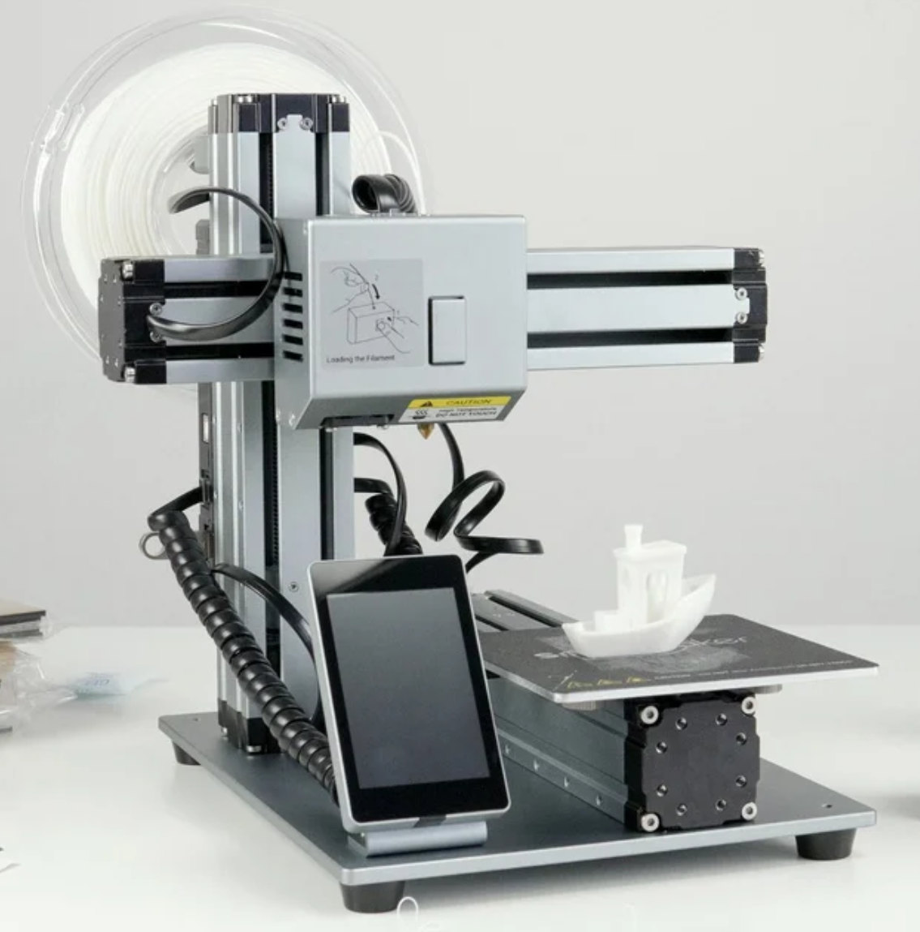
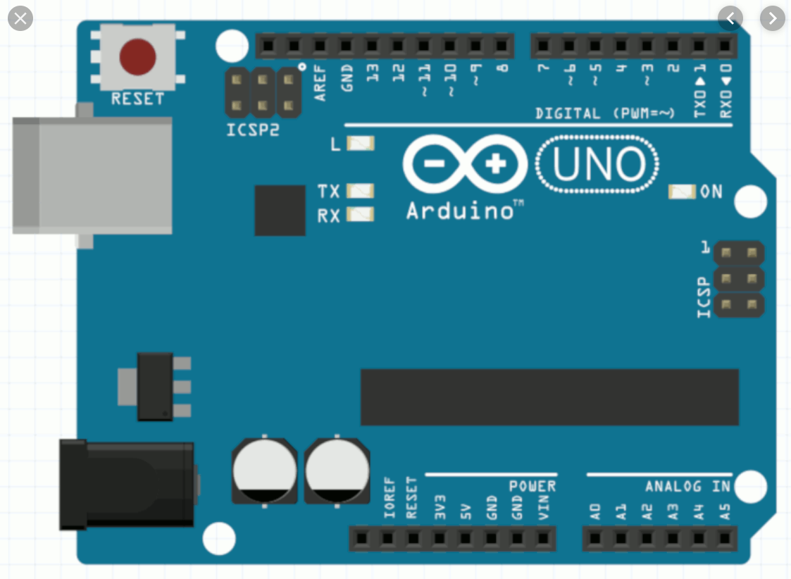
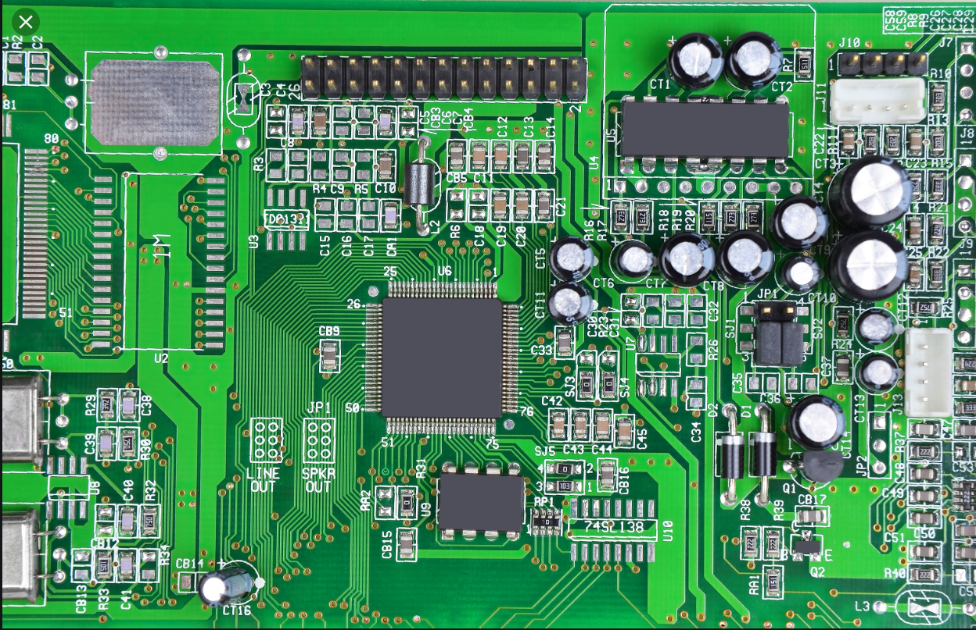

So what has changed?

Slide 6
Course agenda:
What does it mean being a maker?
What are we going to learn?
What is the Arduino platform?
What is a micro controller?
What can I do with a micro controller?
Basic communication protocols
Our general maker’s platform
Available accessories/peripherals/devices
Our first project
Board design
Debug capabilities: logic analyzer, scope and maybe JTAG debugger
3D printing with design

Slide 7
Being a maker, what does it mean?
A maker is an electronic biased hobbyist
You need to have basic and up SW and HW capabilities
And foremost you need passion ☺
Makers these days have huge possibilities very easy to reach
Arduino for example is a very reachable and easy to use maker’s platform
Makers today can easily:
Built their own drones
Do home automation
Build complex gadgets
Build a robot
Imagination will be your only limit (almost ☺)

Slide 8
What are going to learn?
Code and run various examples and exercises on Intel’s makers platform
Pick your own project*
Code it …
Design an electric board, manufacture it, assemble and test it
Learn how to design a 3D case or parts and print it with our 3D printers
Tie it all together and have fun ☺

Slide 9
What makes for a good maker platform?
A cheap micro controller
I/Os - Input and Output pins (Digital and analog)
Easy programmability
Capability to easily connect external accessories/peripherals/devices
IDE - Integrated Development Environment
Bonuses:
File system support
Wi-Fi
Bluetooth
PWM - Pulse-Width Modulation
Wide and active community

Slide 10
The Arduino makers platform – how it all started…
The Arduino project was started at the Interaction Design Institute Ivrea (IDII) in Ivrea, Italy
In 2003 Hernando Barragán created the development platform Wiring as a Master's thesis project at IDII – Which was used as the basis for the Arduino platform
Under the supervision of Massimo Banzi and Casey Reas. Casey Reas is known for co-creating, with Ben Fry, the Processing development platform
The project goal was to create simple, low cost tools for creating digital projects by non-engineers!
The initial Arduino core team consisted of Massimo Banzi, David Cuartielles, Tom Igoe, Gianluca Martino, and David Mellis, but Barragán was not invited to participate
Millions of Arduino boards are in use around the world!

Slide 11
Arduino
As said Arduino was born at the Ivrea Interaction Design Institute as an easy tool for fast prototyping, aimed at students without a background in electronics and programming. As soon as it reached a wider community, the Arduino board started changing to adapt to new needs and challenges, differentiating its offer from simple 8-bit boards to products for IoT applications, wearable, 3D printing, and embedded environments. All Arduino boards are completely open-source, empowering users to build them independently and eventually adapt them to their particular needs. The software, too, is open-source, and it is growing through the contributions of users worldwide.

Slide 12
The Arduino makers platform
Arduino platform offers:
A variety of cheap boards
A simple to use IDE that supports C\C++
Open source
Huge community
Training and example projects are all over the web and within the IDE!
Visual Micro provides a plug-in for visual studio to provide the ultimate IDE
Other micro processors platforms were built to use the Arduino IDE and offers much better capabilities at a very low cost!
Such as Espressif System’s ESP8266 and ESP32

Slide 13
Arduino options
Board Name | CPU | Clock | SRAM | FLASH | EEPROM | UART | PWM | Analog Out | DAC Bits | Digital | Analog In | ADC Bits | VCC | I2C | CAN | SPI | I2S | Touch Sensors | WiFi | Bluetooth | Board price
Arduino Due | SAM3X8E - 32 bit | 84MHz | 96kb | 512kb | N/A | 4 | 12 | 2 | 12 | 70 | 12 | 12 | 3.3V | 2 | 1 | 1 |  |  |  |  | 11$
Arduino Zero | ATmega328 - 32 bit | 48MHz | 32k | 256k | N/A | 2 | 18 | 1 | 10 | 20 | 6 | 12 | 3.3V | 1 |  |  |  |  |  |  | 10$
Uno (R3) | ATmega328 - 8 bit | 16MHz | 2k | 32k | 1k | 1 | 6 | N/A | N/A | 14 | 6 | 10 | 5V | 1 |  |  |  |  |  |  | 5$
Arduino Mega 2560 | ATmega2560 - 8 bit | 16MHz | 8k | 256k | 4k | 4 | 14 | N/A | N/A | 54 | 16 | 10 | 5V | 1
Arduino Nano 3.0 | ATmega328 - 8 bit | 16MHz | 2k | 32k | 1k | 1 | 6 | N/A | N/A | 14 | 8 | 10 | 5 | 1
Arduino Mini | ATmega328 - 8 bit | 16MHz | 2k | 32k | 1k | 1 | 6 | N/A | N/A | 14 | 8 | 10 | 5 | 1
Arduino Micro | ATmega32u4 - 8 bit | 16MHz | 2.5k | 32k | 1k | 1 | 7 | N/A | N/A | 25 | 12 | 10 | 5V | 1 |  |  |  |  |  |  | 3$
Arduino Nano 33 BLE Sense | UBLOX NINA B306 | 64MHz | 256KB | 1MB |  | 1 |  |  |  | 8 | 13 |  | 3.3V | 1 |  | 1 |  |  | Yes | Yes | 30$
ESP8266 | Tensilica LX106 32 bit | 160MHz | 80K | 4MB | 4K | 1 | SW | N/A |  | 9 | 1 | 10 | 3.3V | 1 |  | 1 |  | No | Yes | No | 3$
ESP32 | Tensilica Dual LX6 32 bit With FreeRTOS OS | 240MHz | 512K/4MB | 4MB | 4K | 2 | 1/16 | 2 | 12 | 36 | 18 | 12 | 3.3V | 1 | 1 | 2 | 2 | Yes | Yes | Yes | 4-5$

Slide 14
What is a micro controller?
Basically it is a system on a chip – meaning …
It has almost all we need to run a computing system in a single chip:
CPU
Dynamic memory
Non volatile memory
Communication ports
I/O ports
The rest depends on the complexity of the micro controller

Slide 15
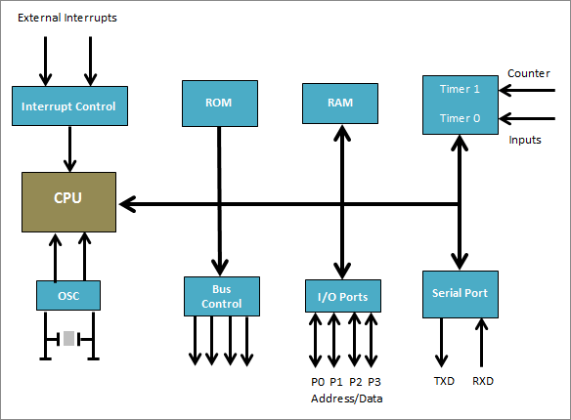
General Block diagram

Slide 16
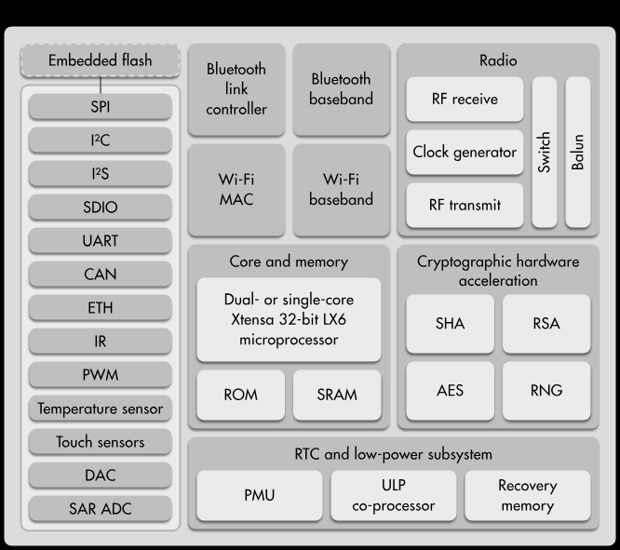
Esp32 block diagram

Slide 17
More about the esp32
Runs under Arduino’s IDE
Dual 32 bit CPU cores @ 240MHz
Support true multi threading with bounding to specific CPU
512KB of SRAM (extra 4MB through SPI device)
4/16MB of flash memory
EEPROM (4KB)
Full power management control - Deep sleep etc.
CPU 64-bit counter
Native OTA (Over the Air Update)
Native file system (SPIFFS) with very easy way to upload an image
Running FreeRTOS operating system which can be utilized or ignored
Many external interfaces with DMA for accelerated data transfer
Wi-Fi and Bluetooth easily accessible
Ultra low power co-processor for extreme power management control

Slide 18
And the best part….
10 NIS for part with 4MB SRAM!

Slide 19
What can I do with a micro controller?
Many electric devices such as laundry machines, refrigerators, micro waves are powered by micro controllers
Advanced toys such as drones, robots and much more …
Home automation
IOT
Simple to highly advanced digital projects

Slide 20
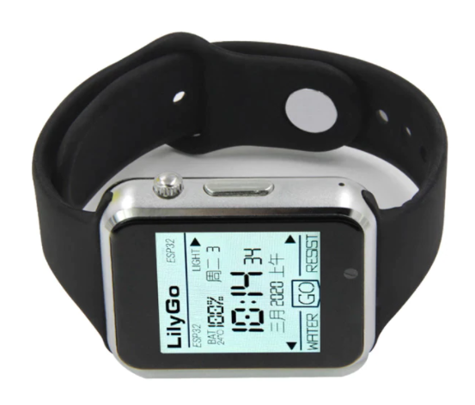
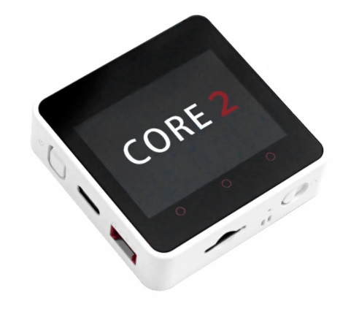
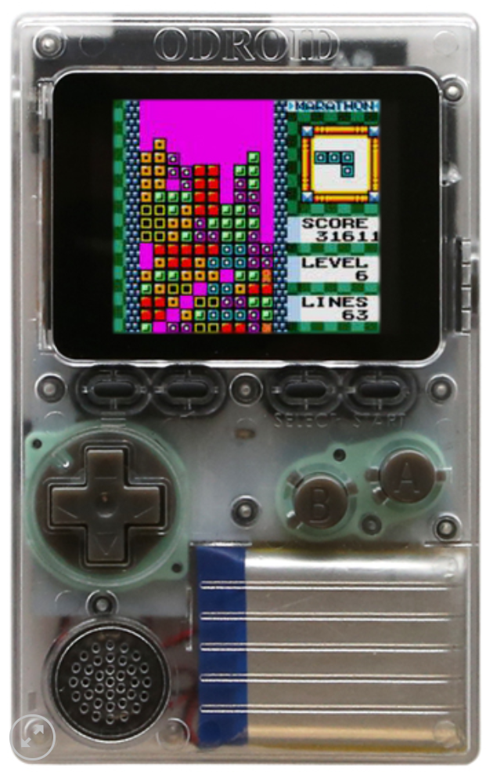
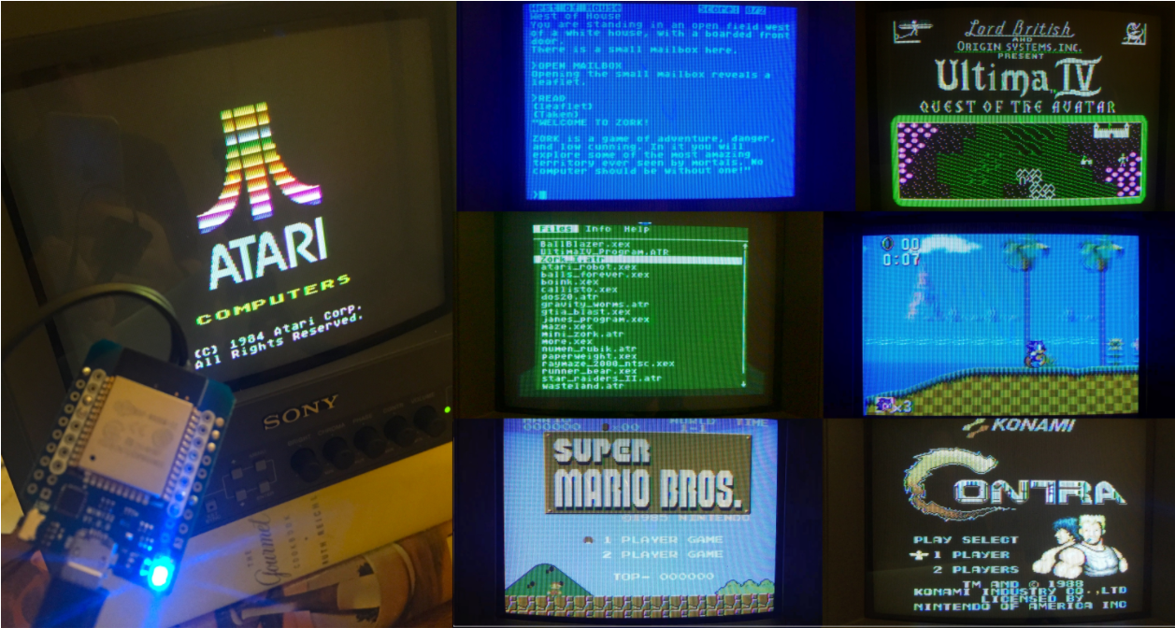
Some esp32 projects…

Slide 21
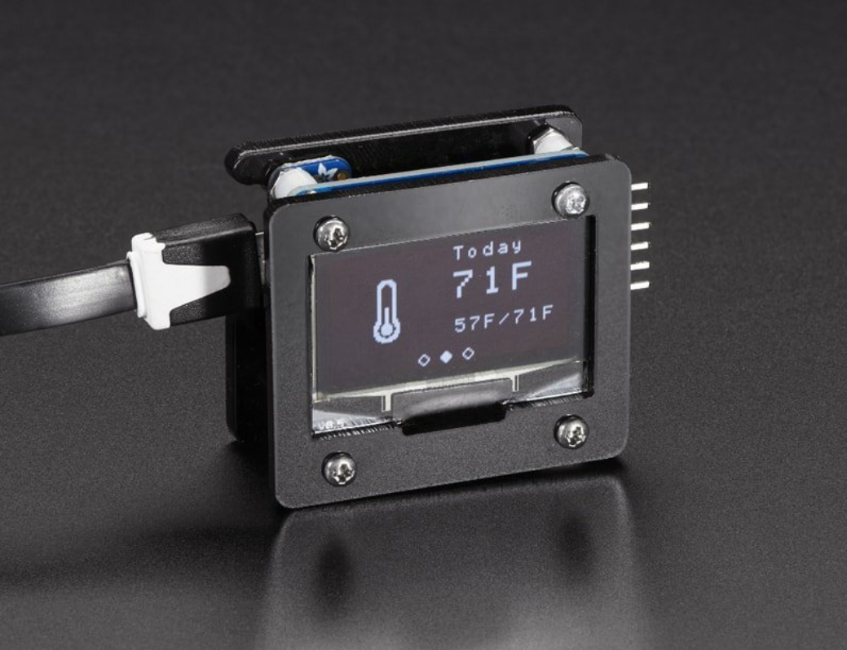
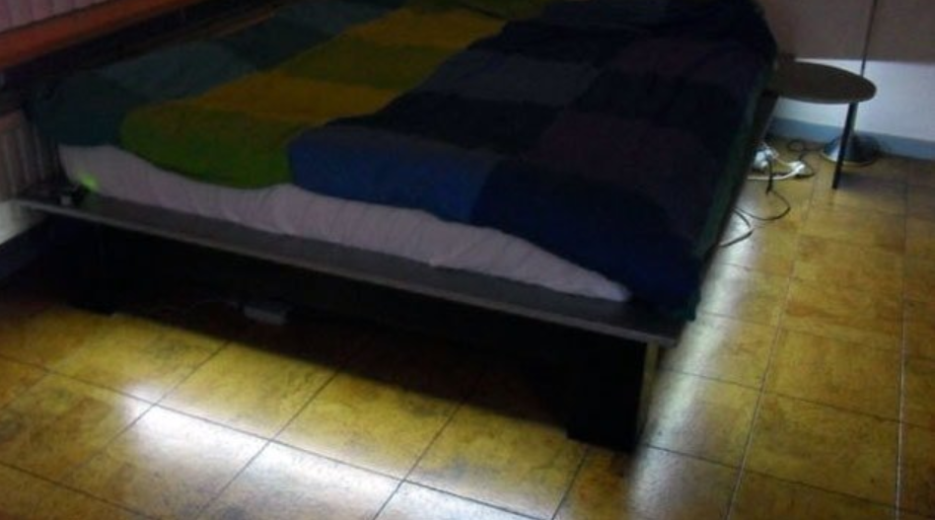
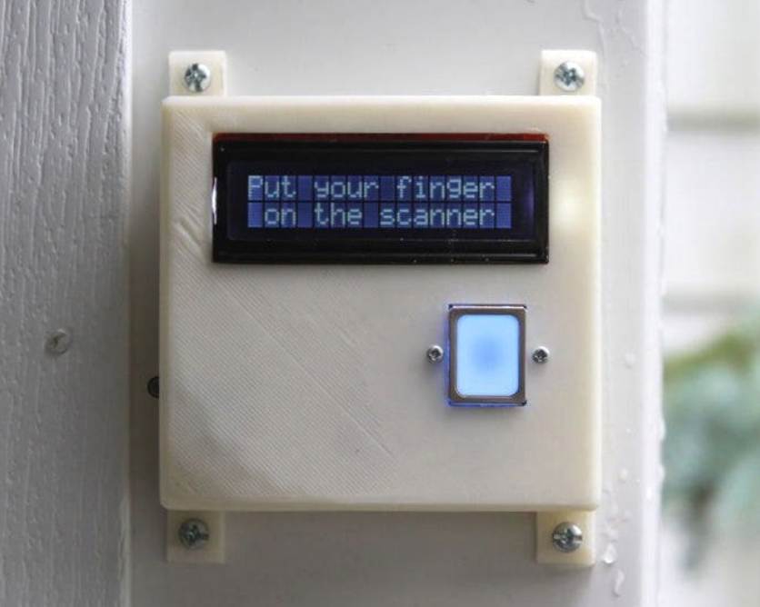
Cool examples

Slide 22
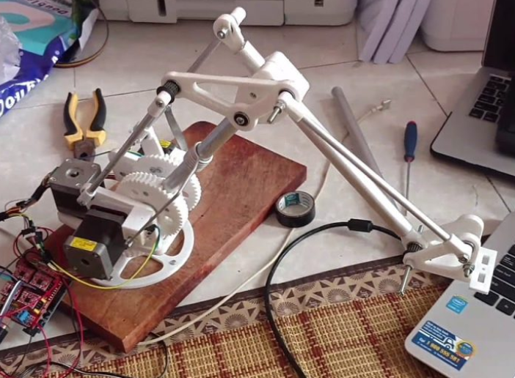
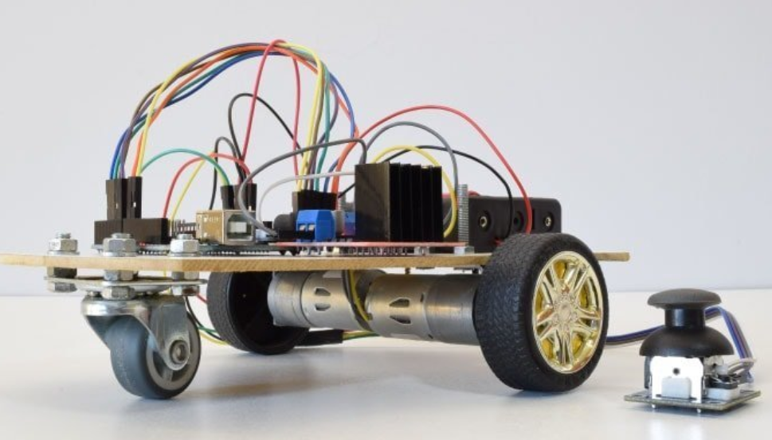
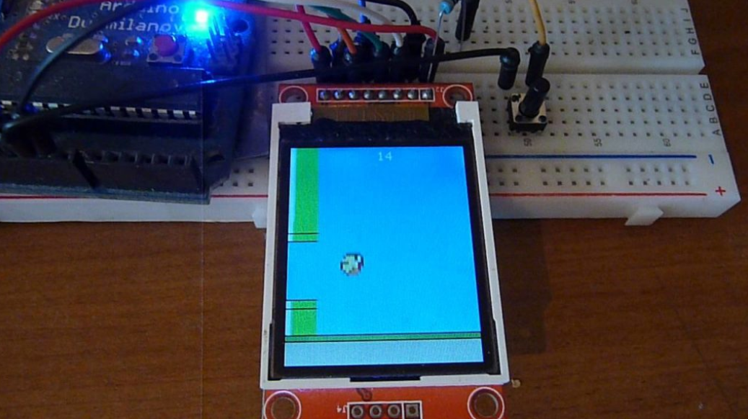
Cool examples

Slide 23
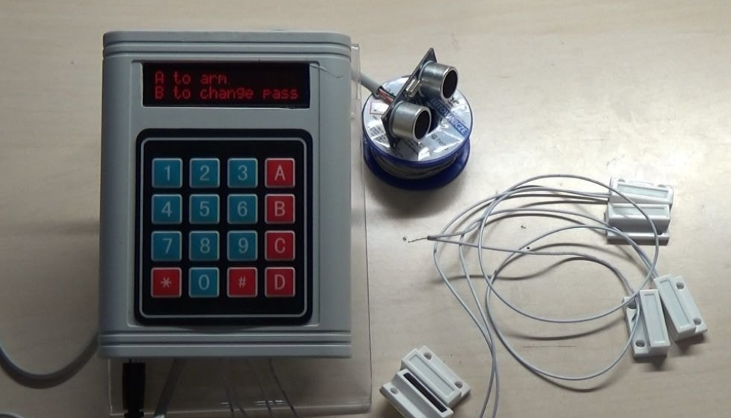
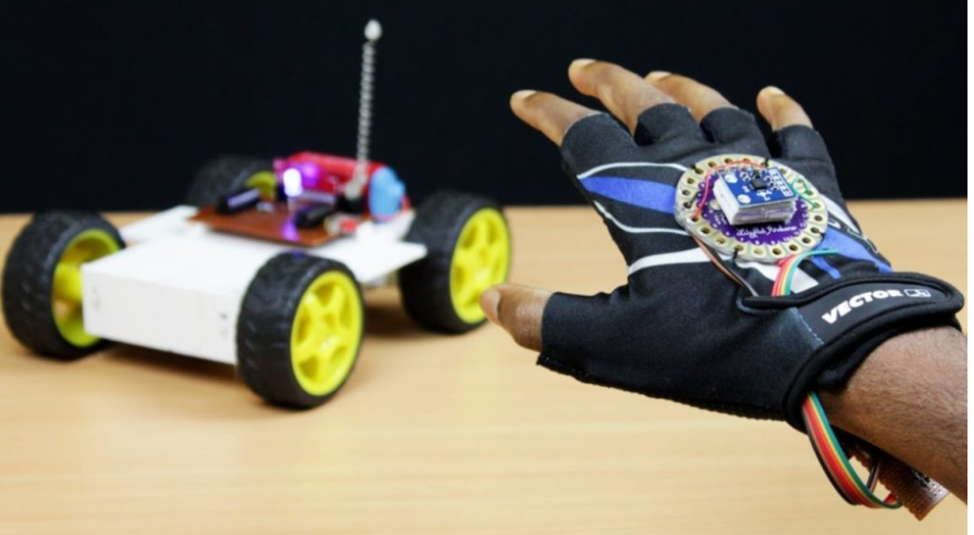
Cool examples

Slide 24
accessories/peripherals/devices - Properties
Communication protocol voltage level
Voltage supply
Power consumption
Band Width
SW Driver
Timing specifications
Setup, hold and the alike
Max frequency (when relevant)
Protocol
Sync – meaning using clock (limited frequency) or sync signals
A-Sync
Data assurance\protection using (parity, ECC, CRC etc.)

Slide 25
What is a device driver?
A set of SW functions to enable easy operation and communication of/with a device
Good driver:
Has easy to use and understand API (Application Programming Interface)
Can be easily ported to similar devices

Slide 26
Basic communication protocols
Devices can be connected physically by copper wires or over the air (Wi-Fi, Bluetooth, RF, WEB)
There are various communication protocols, some are standard and some are unique
Simple protocols are: (Low to medium speed and bandwidth)
I2C (Two wires – data and clock) (100 or 400 KHz) – can serve many devices concurrently
UART (RS232) (9600 up to 115200 bps) – only one device per interface
SPI - Serial Peripheral Interface (1 – 100 MHz, data width 1 up to 8 bit) - – can serve many devices concurrently
RF (LoRa and more)
Advanced protocols (Medium to very high speed and bandwidth)
Bluetooth
Wi-Fi: Ethernet – TFTP, UDP,WEB
PCIe (up to 16GHz 16 bit width)
USB2\3 (up to 10GHz)
Thunderbolt (up to 40GHz)

Slide 27
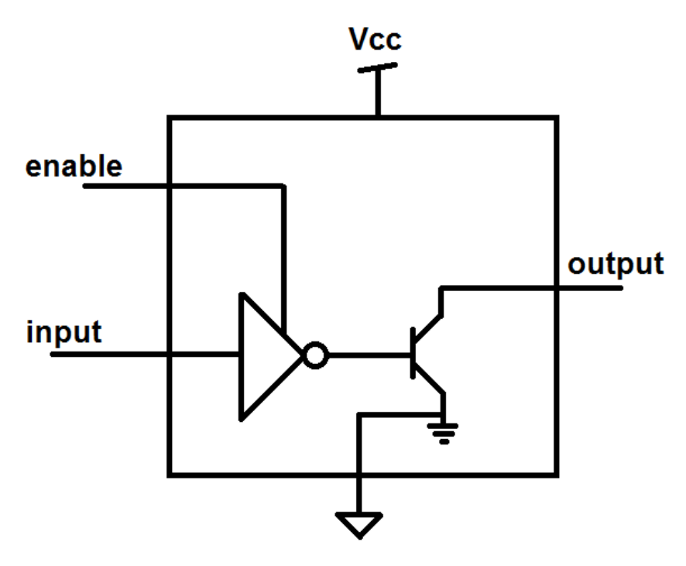
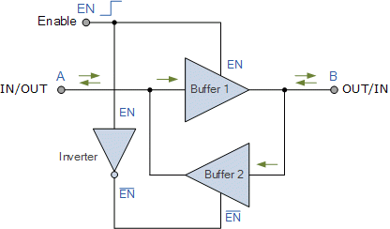
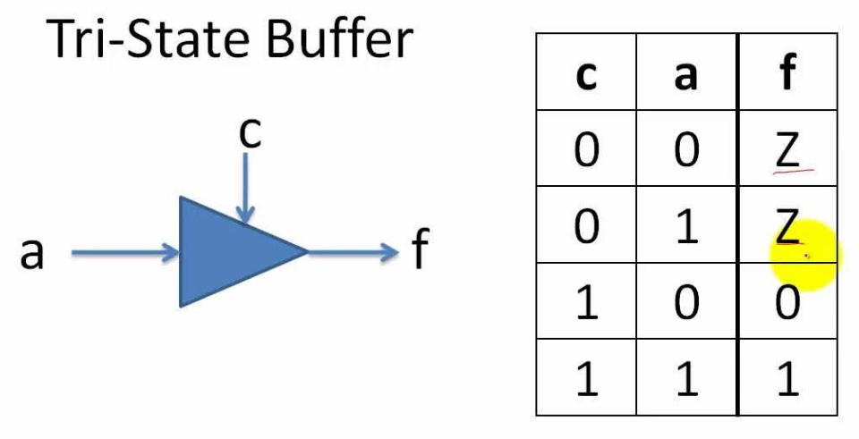
Open drain buffer: Either drives ground or float the output
A pull up resistor is needed to drive logic 1
Bi-Directional I/O
Tri state buffer:

Slide 28
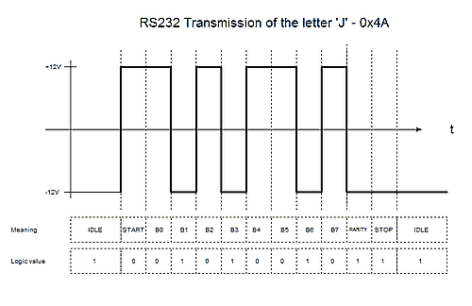
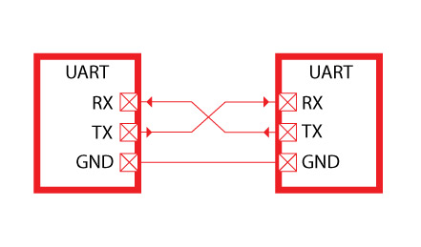
RS232 - UART
Was born in 1960
In the basic mode uses two signals: RX and TX (Receive and Transmit)
Works at speeds from 4800 (bits per second) up to 921000 (usually 115200 is being used)
Works at various voltages (although the standard is +/- 12V)
Used by most of the micro controllers as the main communication port
Today mostly used using USB to UART device

Slide 29
Configuration of RS232
Both sides must be set with the same configuration and voltage level*
BAUD rate (speed – 9600, 115200 or any other supported speed)
Use parity bit or not (in most cases not used)
Number of stop bits: 1 or 2 (in most cases 1 stop bit)

Slide 30
End to end example

Slide 31

I2C Protocol (Inter-Integrated Circuit)
Defined by Philips for variety of simple devices such as
EPROM, Cameras, simple LCDs, modems, I/O expanders and more
Each family of devices has a unique address prefix (There some out of spec devices)
Very low speed bus: 100 – 400 KHz (new devices might support 1 M\bit)
Two signal only: SCL (Clock), SDL (Data)
No chip select, address selectable devices (7 or 10 bit)
Open drain I/O (Must have pull up resistors, usually 4.7K)
Master and slave methodology
Some device has fixed 4-6 address bits and the rest can be set on board

Slide 32
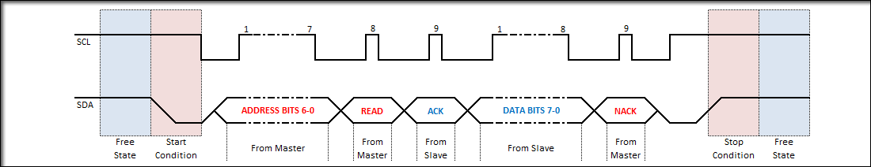
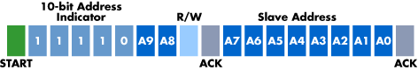
I2C wave form
Master
SCL
SDA
Slave 1
Address: 0x20
Slave 1
Address: 0x38

Slide 33
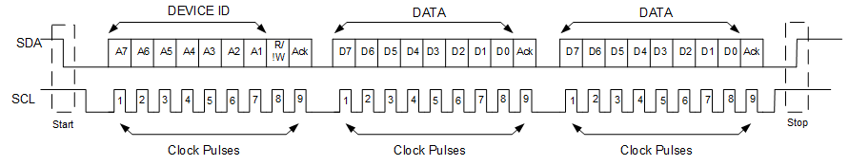
I2C multiple Read\Write
No stop bit

Slide 34
I2C Code example
Wire.begin(-1/*SCL Pin*/, -1/*SDA Pin*/, 100000);
// Read
Wire.requestFrom(address,(uint8_t)1/*Size*/);
if(Wire.available()) // If bytes are available to be received
{
byte dataIn = Wire.read();
}
// Write
Wire.beginTransmission(address);
Wire.write(data);
Wire.endTransmission();

Slide 35
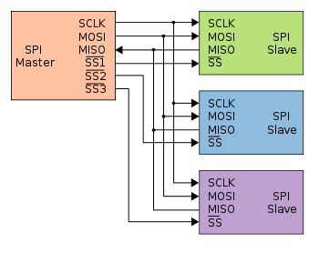
SPI - Serial Peripheral Interface
Much higher performance than UART or I2C
1 bit data (MOSI, MISO, CLOCK, CS)
4 or 8 bits data (CLOCK, CS, bi-directional D0-D7)
Bus topology – using chip select to address specific device
Master and slave methodology
Up to 166MHz (DDR)
Mostly used for flash memories, SD cards, simple LCDs, LoRa transmitters and more

Slide 36
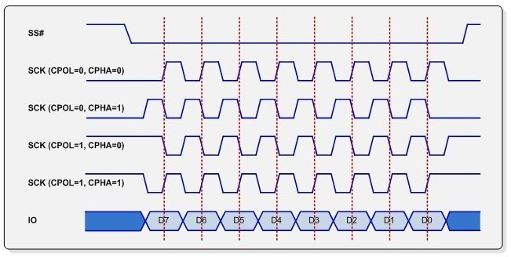
SPI Working modes
SPI mode | Clock polarity (CPOL/CKP) | Clock phase (CPHA)
0 | 0 | 0
1 | 0 | 1
2 | 1 | 0
3 | 1 | 1
CPOL - Clock polarity
CPHA - Clock phase

Slide 37
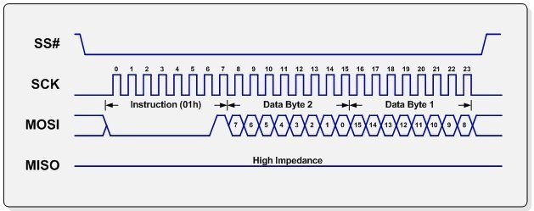
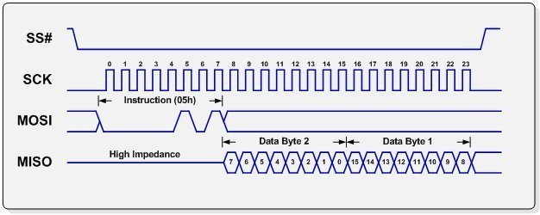
Read\Write (From flash memory) – 1 bit
Dummy cycles
Are optional

Slide 38
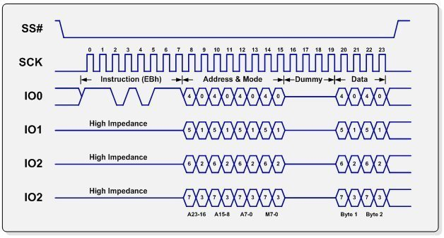
Read\Write (From flash memory) – 4 bit
Dummy cycles to enable
I/O direction change

Slide 39
Available accessories/peripherals/devices
Sensors: Motion, distance, temperature, color, light, smoke, gas, humidity and more
Input: Potentiometers, simple on\off buttons, touch devices, analog joy sticks and more
Displays: LCD and LED matrix
Storage: Flash memory, SD cards, I2C EEPROM
Servo and DC motors
Physical and solid state relays
Infrared transmitters and receivers
RF based I/O
Battery chargers
RTC (Real time clock)
GPS, accelerometers
3G modem with SIM card supporting calls and SMS send\receive
Finger print sensor
Just search the web and you will be amazed by what is out there!

Slide 40
Getting started …

Slide 41
Building a project
Define the project
System requirements specifications
Block diagram
Computing needs
Accessories\Peripherals\Devices needed
Budget
Choosing the right micro controller and board
Choosing the right Accessories\Peripherals\Devices
Sometimes same devices uses different protocols
We need to make sure the voltage levels are compatible
Communication channel are compatible with our MC and has no BW limitations
We need a PC usually running widows on which:
We install the Arduino IDE
Connecting the micro controller board using a USB port

Slide 42
Basic code in Arduino
void setup() {
// put your setup code here, to run once:
}
void loop() {
// put your main code here, to run repeatedly:
}

Slide 43
Board design process
Block diagram
Parts selection
Schematic
DRC + Net List check
Board definitions
Number of layers
Conductor’s width (Net classes)
Placement
Routing
DRC + placement check
Generate production files
Send to production
Assembly
Test al lab ☺

Slide 44
List of Projects
Led on\off using simple physical button
LCD simple drawing
WEB based Led on\off (Local and over the cloud)
Bluetooth heart rate monitor
Step motor operation
Advanced LCD application
File System
OTA – over the air SW update

